Slide 1

Independent Study Report 6
Made by Anees
Submitted to Dr Yahya Zweiri, Mohammed Chehadeh

Slide 2
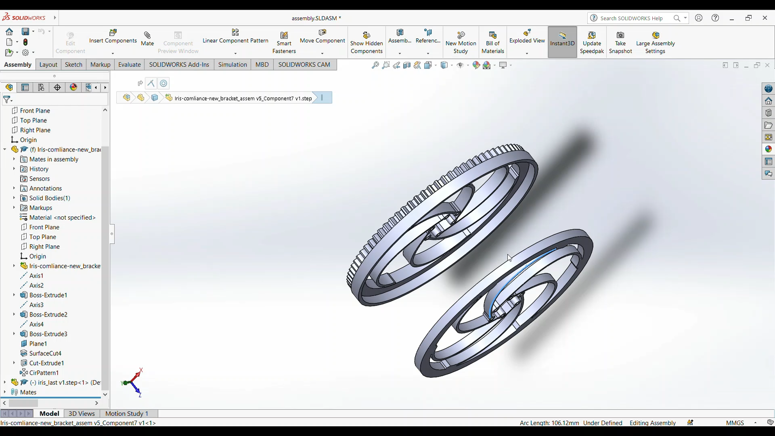
Design Changes
The design in the Previous model proved too heavy for qdrone, we redesigned a lighter mechanism

Slide 3
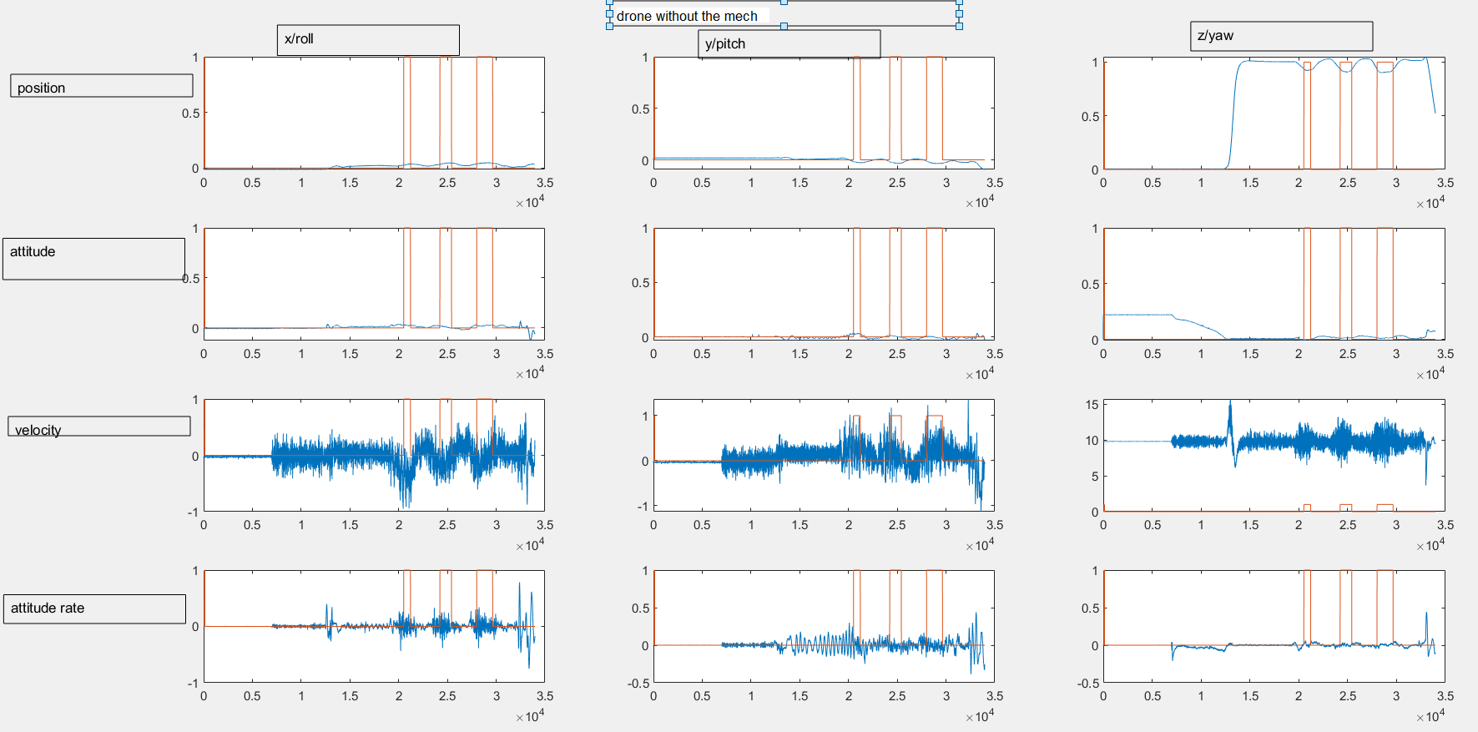
Change in drone behavior with the mechanism
The drone response was slightly changed due to the addition of the mechanism. Below is the ideal behavior without the mechanism

Slide 4
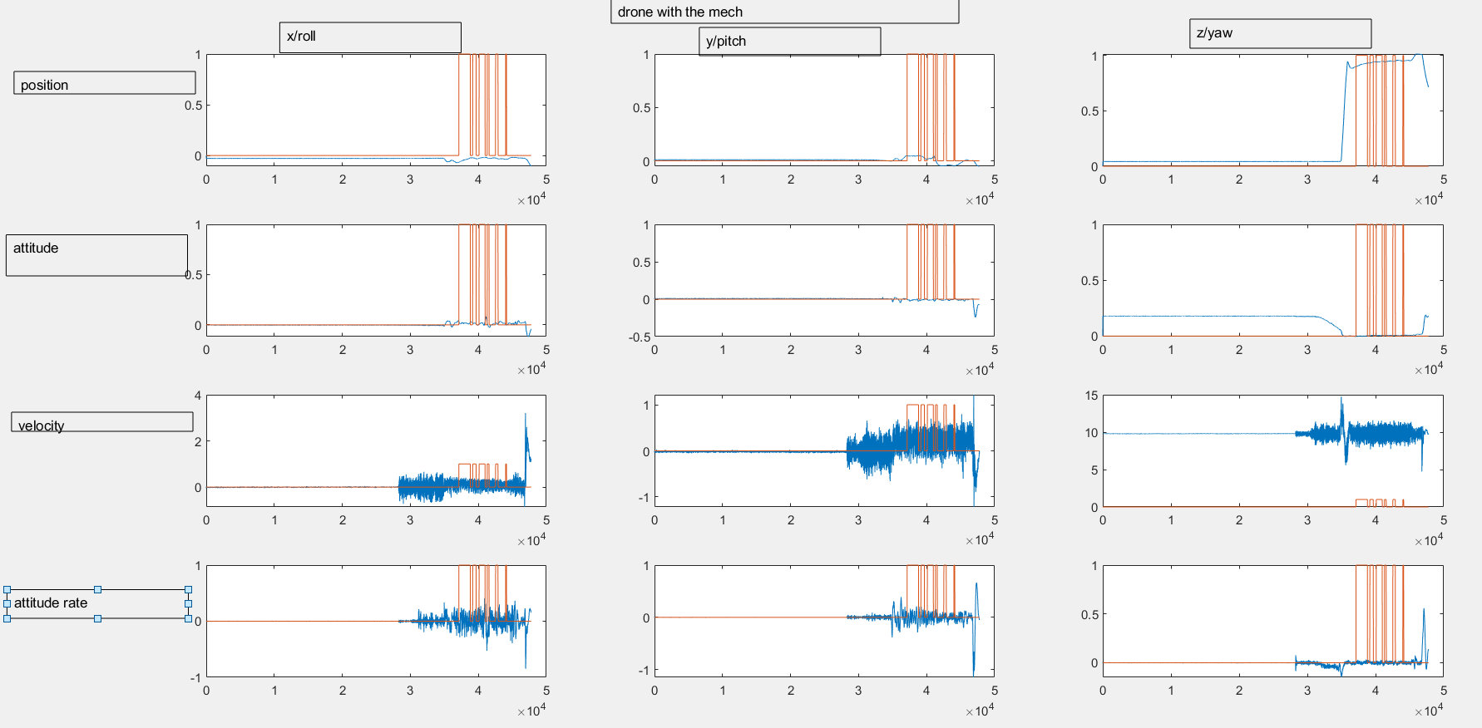
This is the behavior of the drone after adding the mechanism. Significant difference is seen in the z position. It must be noted that during this test, there were no pulls, but it continuously detected pulls as seen from the orange graph

Slide 5
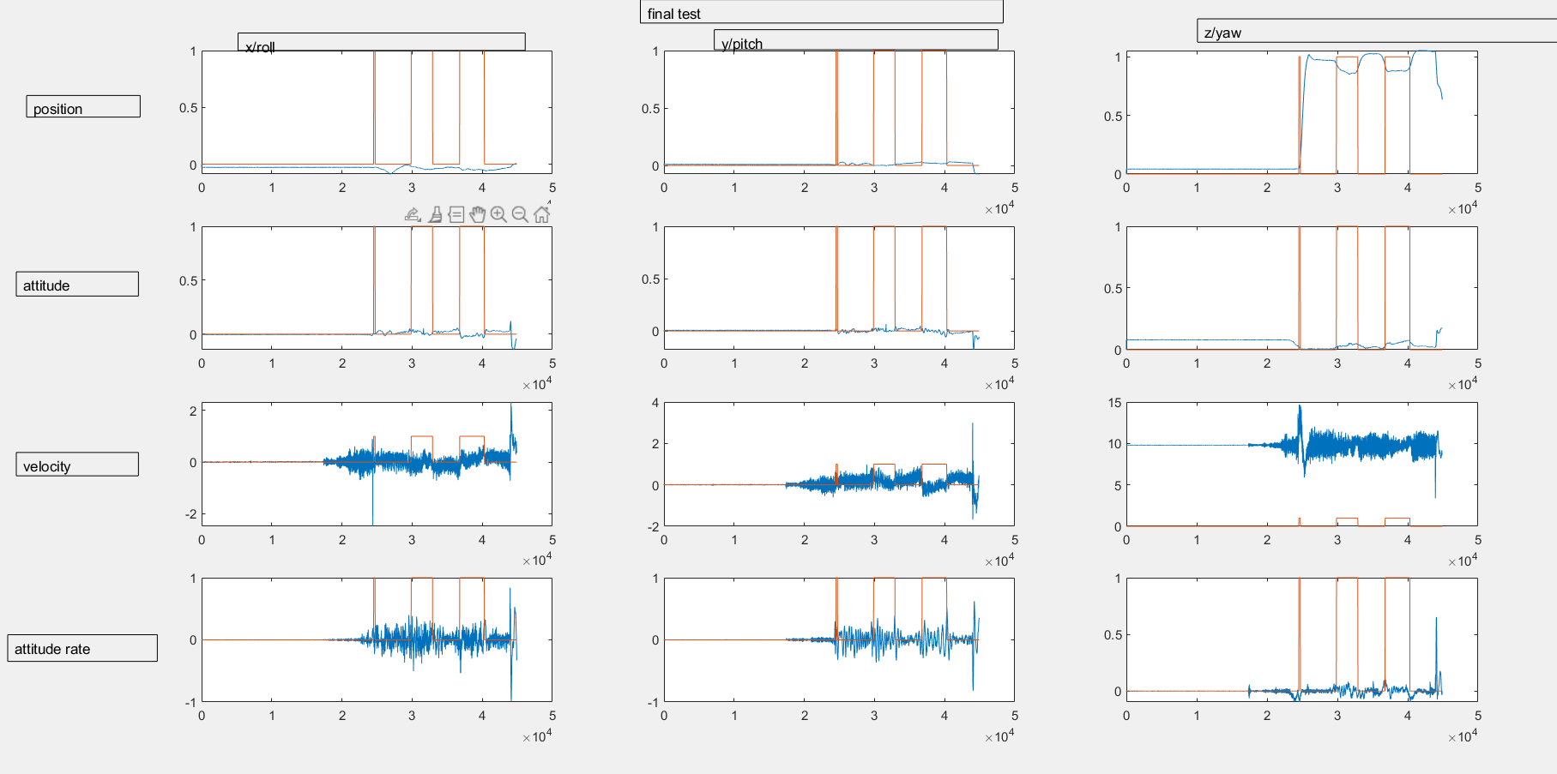
After tuning the parameters of the drone with the mechanism, we were able to get better response. Now the model predicts pulls accurately

Slide 6
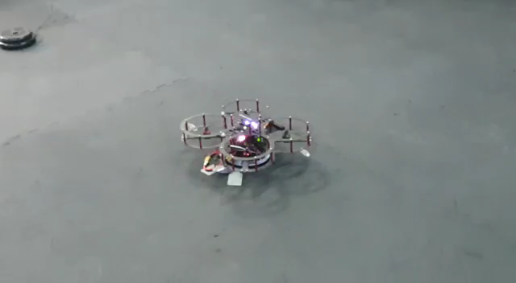
TEST with a cup

Slide 7
Further work
The classifier only works for the qdrone platform, It might be beneficial to train the classifier on different platforms, or even different behaviour of the qdrone by changing the controller parameters of the qdrone.

